Slide 1
Progress Reporting (Week 3)
Design and implement the model of smart garden
Group 1 - Increment 1

Slide 2
Increment 1 – Goals & Deliverable
Goals
Understanding interfaces and protocol in system.
Identify sensors, will be used in system.
Given clearly model for overview of system.
Order fixed hardware.
Given a basic design in backend and framework.
Deliverable
Software Project Management Plan
Software Requirement Specification

Slide 3
Increment 1 – To do list
Research:
Temperature and humidity sensors
I²C: connect sensors with CC1310 in Sub Controller
UART: communication in Main Controller (CC1310 with Raspberry)
RF: connection between Main Controller with Sub Controller
Load indexes of sensors to MCU
Tools and technique to build web server
Android Application
Design
System Database
Webserver

Slide 4
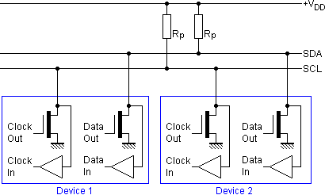
Increment 1 – Completed
Research I²C protocol (Nghihh & Chinhph)
Structure and Principles

Slide 5
Increment 1 – Completed
Research I²C protocol (Nghihh & Chinhph)
Activity Mode
Based on Speed:
+ Standard Mode
+ Low-Speed Mode
Based on Master – Slave Relative
+ One Master – One Slave
+ One Master – Many Slave
+ Many Master – Many Slave

Slide 6
Increment 1 – Completed
Research I²C protocol (Nghihh & Chinhph)
Activity Mode
Based on Speed:
+ Standard Mode
+ Low-Speed Mode
Based on Master – Slave Relative
+ One Master – One Slave
+ One Master – Many Slave
+ Many Master – Many Slave

Slide 7
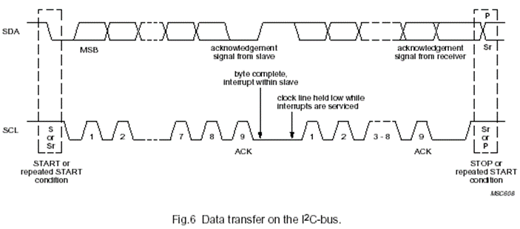
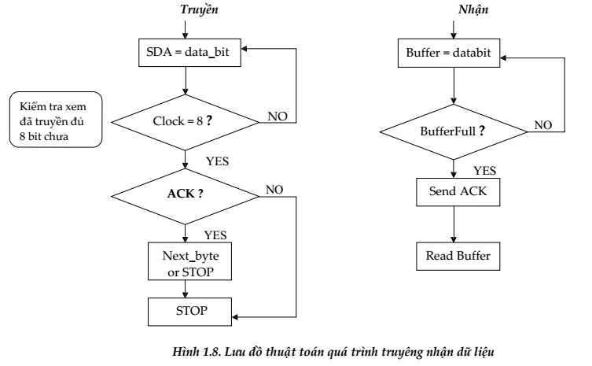
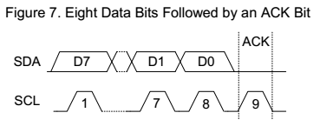
Increment 1 – Completed
Research I²C protocol (Nghihh & Chinhph)
Addressed and Data Transfer

Slide 8
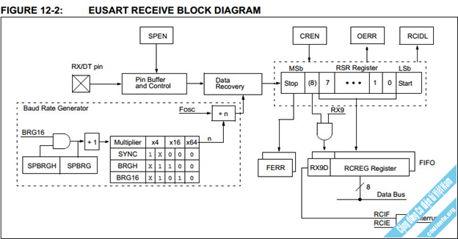
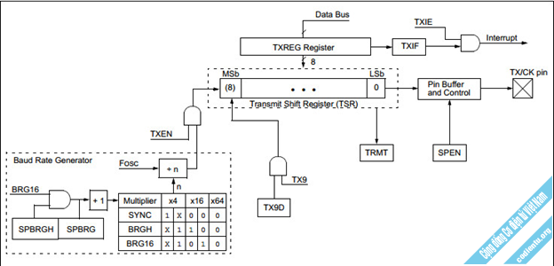
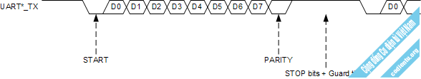
Increment 1 – Completed
Research UART Protocol (Nghihh)

Slide 9
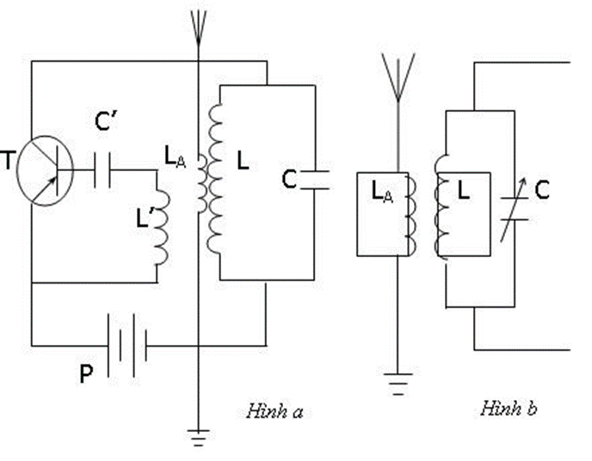
Increment 1 – Completed
Research RF connection

Slide 10
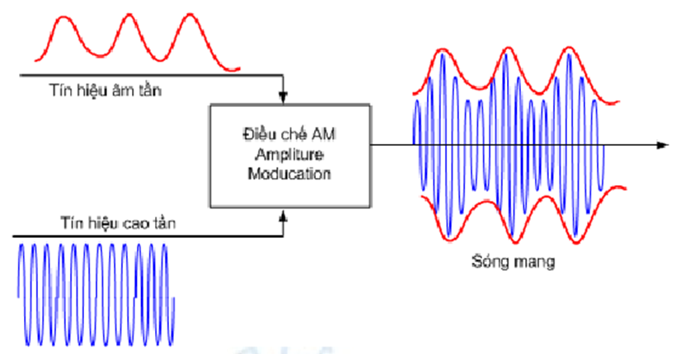
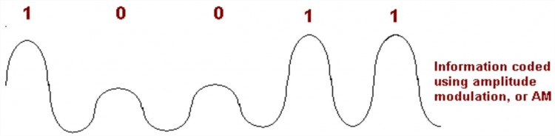
Increment 1 – Completed
Research RF connection
AM

Slide 11
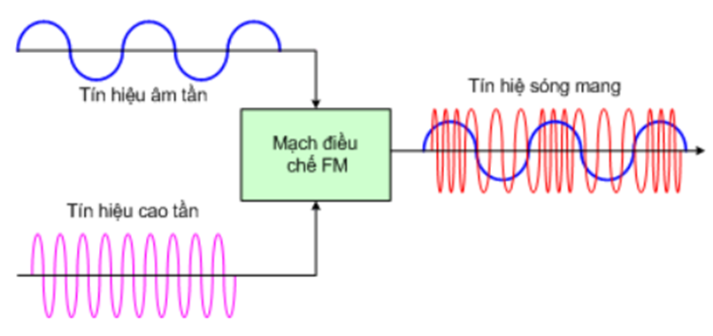
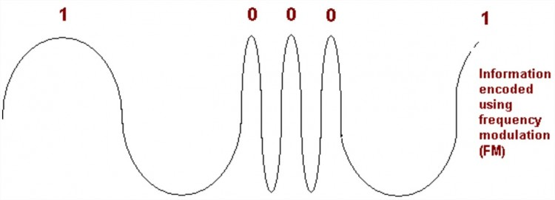
Increment 1 – Completed
Research RF connection (Chinhph)
FM

Slide 12


Increment 1 – Completed
Tools & Technique to build Web server (Phaplv)

Slide 13
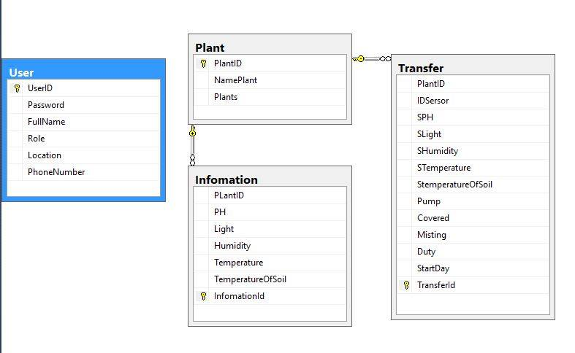
Increment 1 – Completed
Design Database (Sangpt, Phaplv)

Slide 14
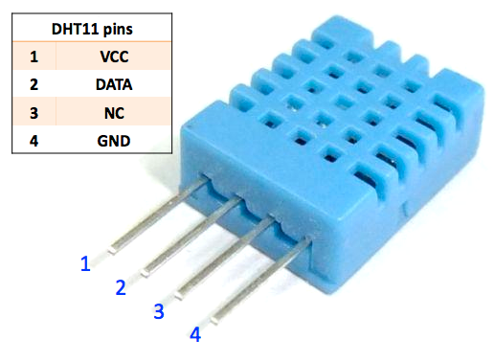
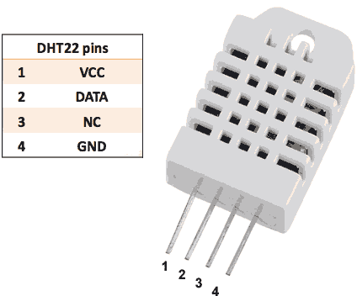
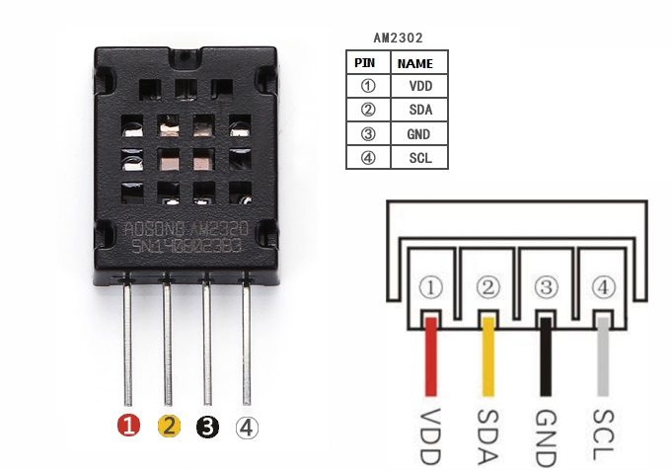
Increment 1 – In progress
Temperature and humidity sensors (Sangpt)

Slide 15
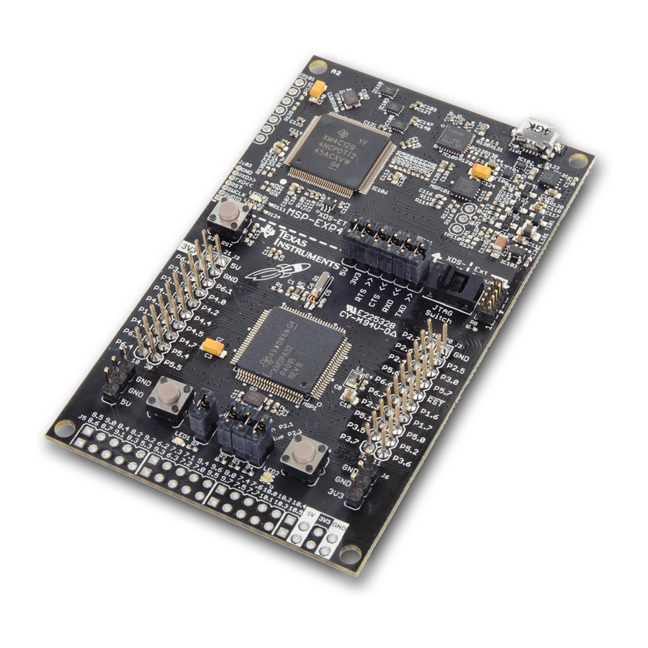
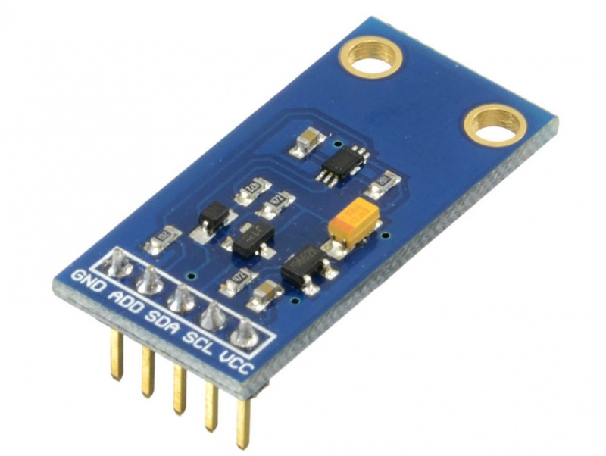
Increment 1 – In progress
Load indexes of sensors (Sangpt)

Slide 16
Increment 1 – In progress
Design Webserver – MVC (Phaplv)

Slide 17
Increment 1 – Delay & Risks
Hardware: late of order MCU and soil moisture sensor.
Lack of face to face working together.
Lack of member share of understand.

